Slide 1
Test simple architecture
2022.01.10
김현정

Slide 2
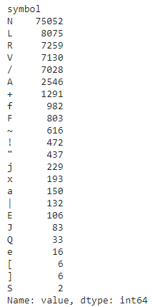
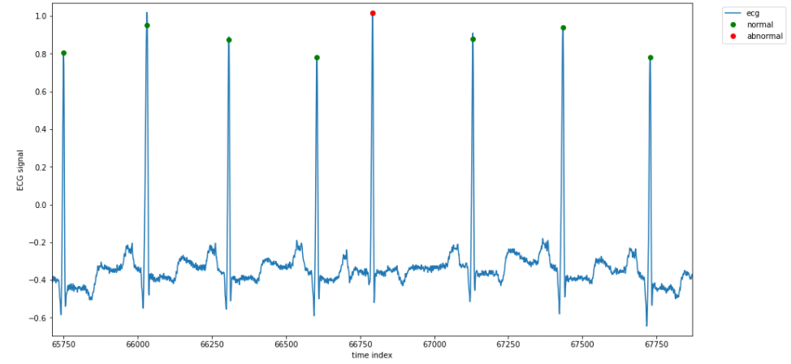
Symbol distribution

Slide 3
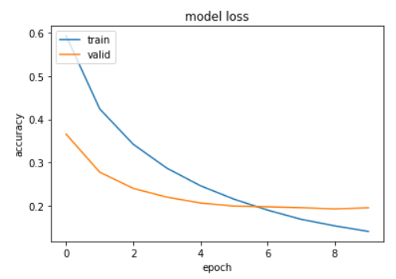

Slide 4
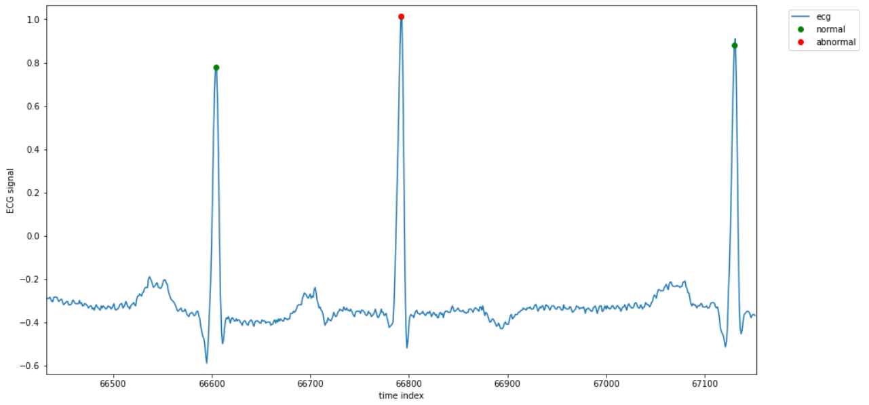
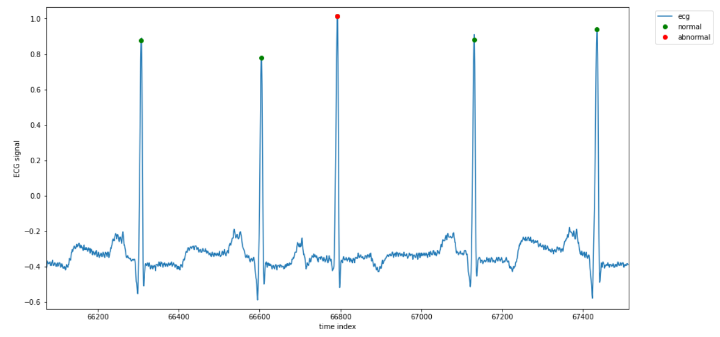
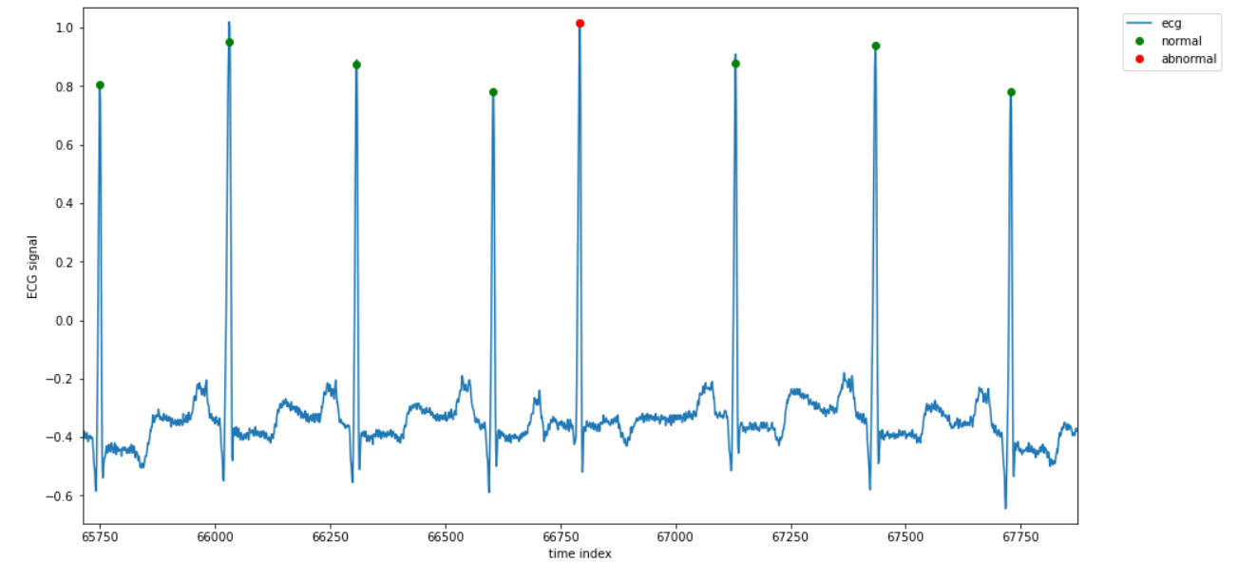

Slide 5
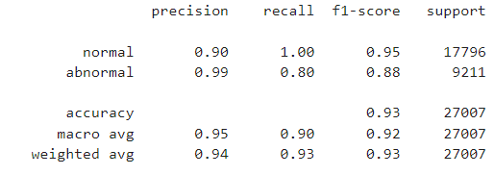
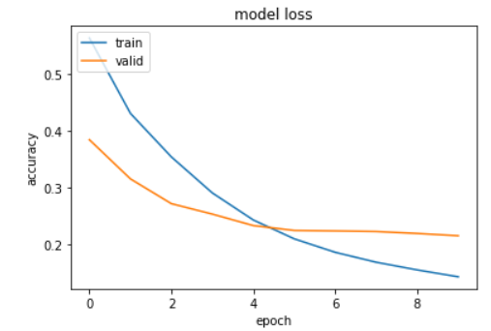
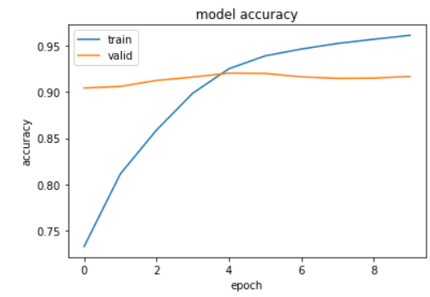
Window size = 1

Slide 6
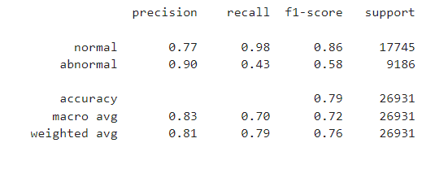
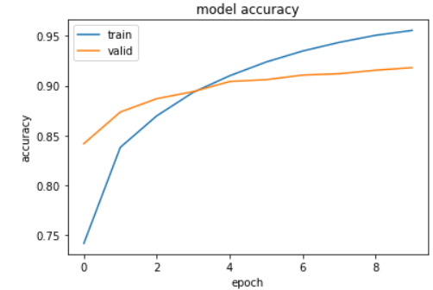
Window size = 2

Slide 7
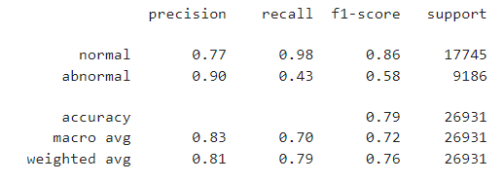
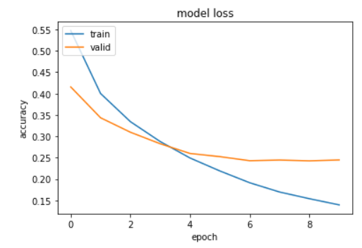
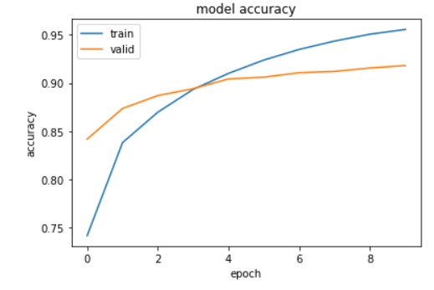
Window size = 6

Slide 8
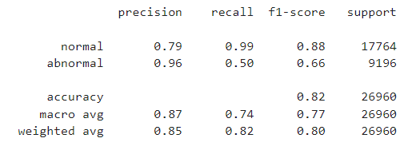
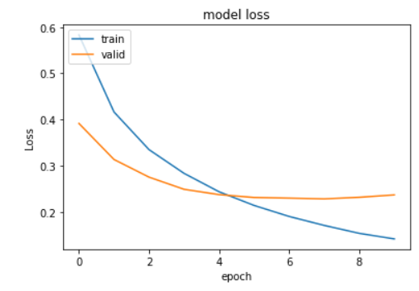
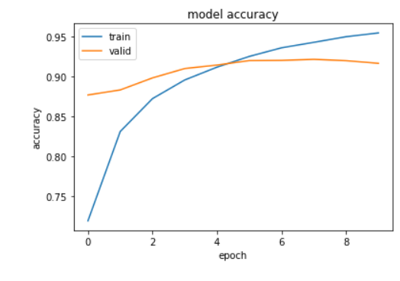
Window size = 4

Slide 10
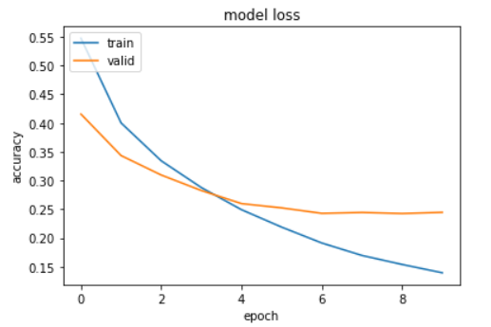
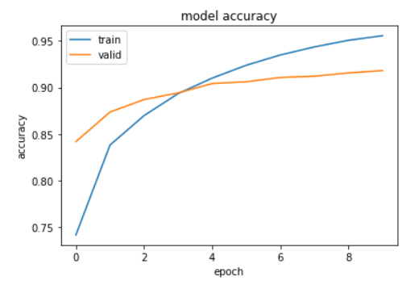
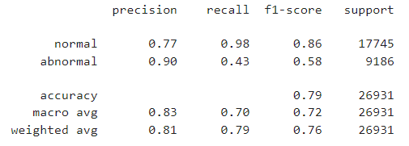

Slide 12
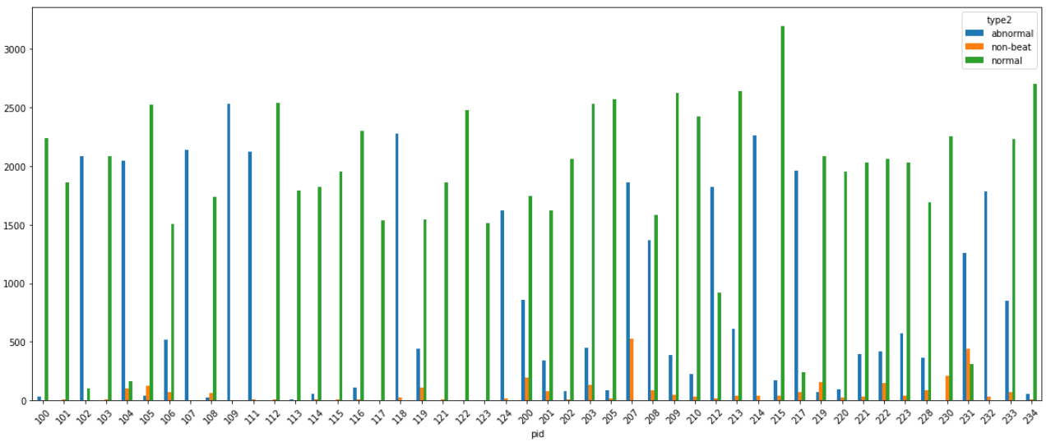
Data Distribution_1
 | type2 | 100 | 101 | 102 | 103 | 104 | 105 | 106 | 107 | 108 | 109 | 111 | 112 | 113 | 114 | 115 | 116 | 117 | 118 | 119 | 121 | 122 | 123 | 124 | 200 | 201 | 202 | 203 | 205 | 207 | 208 | 209 | 210 | 212 | 213 | 214 | 215 | 217 | 219 | 220 | 221 | 222 | 223 | 228 | 230 | 231 | 232 | 233 | 234
1 | abnormal | 34 | 3 | 2088 | 2 | 2048 | 41 | 520 | 2137 | 24 | 2532 | 2124 | 2 | 6 | 59 |  | 110 | 1 | 2278 | 444 | 2 |  | 3 | 1619 | 858 | 338 | 75 | 447 | 85 | 1860 | 1367 | 384 | 227 | 1825 | 610 | 2260 | 168 | 1964 | 72 | 94 | 396 | 421 | 576 | 365 | 1 | 1257 | 1780 | 849 | 53
2 | non-beat | 1 | 11 | 5 | 7 | 100 | 124 | 71 | 3 | 61 | 3 | 9 | 11 | 1 | 11 | 9 | 9 | 4 | 23 | 107 | 13 | 3 | 1 | 15 | 191 | 76 | 10 | 132 | 16 | 525 | 87 | 47 | 35 | 15 | 43 | 37 | 37 | 72 | 158 | 21 | 35 | 151 | 38 | 88 | 210 | 440 | 36 | 73 | 11
3 | normal | 2239 | 1860 | 99 | 2082 | 163 | 2526 | 1507 |  | 1739 |  |  | 2537 | 1789 | 1820 | 1953 | 2302 | 1534 |  | 1543 | 1861 | 2476 | 1515 |  | 1743 | 1625 | 2061 | 2529 | 2571 |  | 1586 | 2621 | 2423 | 923 | 2641 |  | 3195 | 244 | 2082 | 1954 | 2031 | 2062 | 2029 | 1688 | 2255 | 314 |  | 2230 | 2700
4 | Total | 2273 | 1863 | 2187 | 2084 | 2211 | 2567 | 2027 |  | 1763 |  |  | 2539 | 1795 | 1879 |  | 2412 | 1535 |  | 1987 | 1863 |  | 1518 |  | 2601 | 1963 | 2136 | 2976 | 2656 |  | 2953 | 3005 | 2650 | 2748 | 3251 |  | 3363 | 2208 | 2154 | 2048 | 2427 | 2483 | 2605 | 2053 | 2256 | 1571 |  | 3079 | 2753
5 | Abnormal/Total | 0.01 | 0 | 0.95 | 0 | 0.93 | 0.02 | 0.26 |  | 0.01 |  |  | 0 | 0 | 0.03 |  | 0.05 | 0 |  | 0.22 | 0 |  | 0 |  | 0.33 | 0.17 | 0.04 | 0.15 | 0.03 |  | 0.46 | 0.13 | 0.09 | 0.66 | 0.19 |  | 0.05 | 0.89 | 0.03 | 0.05 | 0.16 | 0.17 | 0.22 | 0.18 | 0 | 0.8 |  | 0.28 | 0.02
6 | Normal/Total | 0.99 | 1 | 0.05 | 1 | 0.07 | 0.98 | 0.74 |  | 0.99 |  |  | 1 | 1 | 0.97 |  | 0.95 | 1 |  | 0.78 | 1 |  | 1 |  | 0.67 | 0.83 | 0.96 | 0.85 | 0.97 |  | 0.54 | 0.87 | 0.91 | 0.34 | 0.81 |  | 0.95 | 0.11 | 0.97 | 0.95 | 0.84 | 0.83 | 0.78 | 0.82 | 1 | 0.2 |  | 0.72 | 0.98

Slide 13
Data Distribution_2
 | Type | 100 | 101 | 102 | 103 | 104 | 105 | 106 | 107 | 108 | 109 | 111 | 112 | 113 | 114 | 115 | 116 | 117 | 118 | 119 | 121 | 122 | 123 | 124 | 200
1 | Abnormal | 34 | 3 | 2088 | 2 | 2048 | 41 | 520 | 2137 | 24 | 2532 | 2124 | 2 | 6 | 59 |  | 110 | 1 | 2278 | 444 | 2 |  | 3 | 1619 | 858
2 | non-beat | 1 | 11 | 5 | 7 | 100 | 124 | 71 | 3 | 61 | 3 | 9 | 11 | 1 | 11 | 9 | 9 | 4 | 23 | 107 | 13 | 3 | 1 | 15 | 191
3 | Normal | 2239 | 1860 | 99 | 2082 | 163 | 2526 | 1507 | 0 | 1739 | 0 | 0 | 2537 | 1789 | 1820 | 1953 | 2302 | 1534 | 0 | 1543 | 1861 | 2476 | 1515 | 0 | 1743
4 | Total | 2273 | 1863 | 2187 | 2084 | 2211 | 2567 | 2027 |  | 1763 |  |  | 2539 | 1795 | 1879 |  | 2412 | 1535 |  | 1987 | 1863 |  | 1518 |  | 2601
5 | Abnormal/Total | 0.01 | 0 | 0.95 | 0 | 0.93 | 0.02 | 0.26 |  | 0.01 |  |  | 0 | 0 | 0.03 |  | 0.05 | 0 |  | 0.22 | 0 |  | 0 |  | 0.33
6 | Normal/Total | 0.99 | 1 | 0.05 | 1 | 0.07 | 0.98 | 0.74 |  | 0.99 |  |  | 1 | 1 | 0.97 |  | 0.95 | 1 |  | 0.78 | 1 |  | 1 |  | 0.67
 | Type | 201 | 202 | 203 | 205 | 207 | 208 | 209 | 210 | 212 | 213 | 214 | 215 | 217 | 219 | 220 | 221 | 222 | 223 | 228 | 230 | 231 | 232 | 233 | 234
1 | Abnormal | 338 | 75 | 447 | 85 | 1860 | 1367 | 384 | 227 | 1825 | 610 | 2260 | 168 | 1964 | 72 | 94 | 396 | 421 | 576 | 365 | 1 | 1257 | 1780 | 849 | 53
2 | non-beat | 76 | 10 | 132 | 16 | 525 | 87 | 47 | 35 | 15 | 43 | 37 | 37 | 72 | 158 | 21 | 35 | 151 | 38 | 88 | 210 | 440 | 36 | 73 | 11
3 | Normal | 1625 | 2061 | 2529 | 2571 | 0 | 1586 | 2621 | 2423 | 923 | 2641 | 0 | 3195 | 244 | 2082 | 1954 | 2031 | 2062 | 2029 | 1688 | 2255 | 314 | 0 | 2230 | 2700
4 | Total | 1963 | 2136 | 2976 | 2656 |  | 2953 | 3005 | 2650 | 2748 | 3251 |  | 3363 | 2208 | 2154 | 2048 | 2427 | 2483 | 2605 | 2053 | 2256 | 1571 |  | 3079 | 2753
5 | Abnormal/Total | 0.17 | 0.04 | 0.15 | 0.03 |  | 0.46 | 0.13 | 0.09 | 0.66 | 0.19 |  | 0.05 | 0.89 | 0.03 | 0.05 | 0.16 | 0.17 | 0.22 | 0.18 | 0 | 0.8 |  | 0.28 | 0.02
6 | Normal/Total | 0.83 | 0.96 | 0.85 | 0.97 |  | 0.54 | 0.87 | 0.91 | 0.34 | 0.81 |  | 0.95 | 0.11 | 0.97 | 0.95 | 0.84 | 0.83 | 0.78 | 0.82 | 1 | 0.2 |  | 0.72 | 0.98

Slide 16
References
[1] Cardiologist-level arrhythmia detection and classification in ambulatory electrocardiograms using a deep neural network (2019), Awni Y. Hannun 1,6*, Pranav Rajpurkar 1,6, Masoumeh Haghpanahi2,6, Geoffrey H. Tison 3,6, Codie Bourn2 , Mintu P. Turakhia4,5 and Andrew Y. Ng1
Study
Datasets
from raw single-lead ECG
a training dataset
consisting of 91,232 ECG records from 53,549 patients
continuously records data from a single vector (modified Lead II) at 200Hz. The mean and median wear time of the Zio monitor in our dataset was 10.6 and 13.0days, respectively. Mean age was 69±16 years and 43% were women.
Validation dataset
328 ECG records collected from 328 unique patients
Mean age on the test dataset was 70±17 years and 38% were women
Purpose
to classify 10 arrhythmias as well as sinus rhythm and noise for a total of 12 output rhythm classes
Metrics
Sequence-level metrics: help capture the duration of an arrhythmia, such as its onset and offset within a record,
set-level metrics: focus only on the existence of a rhythm class within a record

Slide 17
Model
End-to-end DNN approaches have
been used more recently showing good performance for a limited set of ECG rhythms, such as atrial fibrillation22,23,36, ventricular arrhythmias21, or individual heartbeat classes20,21,37,38. While these prior efforts demonstrated promising performance for specific rhythms, they do not provide a comprehensive evaluation of whether an end-to-end approach can perform well across a wide range of rhythm classes, in a manner similar to that encountered clinically
a 34-layer network in an end-to-end manner to simultaneously output probabilities for a wide range of distinct rhythm diagnoses
Methods
the 30-s ECG samples of both the training and test datasets were appropriately de-identifed before use
a median of one 30-s record per patient to construct the training dataset
randomly sampled patients exhibiting each rhythm; from these patients, we selected 30-s records where the rhythm class was present
Although the targeted rhythm class was typically present within the record, most records contained a mix of multiple rhythms.
To further improve the balance of classes in the training dataset, rare rhythms such as AVB, were intentionally oversampled, with a median of two 30-s records per patient
For the test dataset, 30-s records of each rhythm were sampled in a similar manner to achieve a greater representation of rare rhythms; however, the test dataset included only a single record per patient

Slide 18
Network architecture (https://github.com/awni/ecg)
34 layers;
to make the optimization of such a network tractable, we employed shortcut connections in a manner similar to the residual network architecture
The network consists of 16 residual blocks with two convolutional layers per block
The convolutional layers have a filter width of 16 and 32*2k filters, where k is a hyper-parameter which starts at 0 and is incremented by 1 every fourth residual block.
Every alternate residual block subsamples its inputs by a factor of 2
. Before each convolutional layer, we applied batch normalization42 and a rectified linear activation, adopting the pre-activation block design
The first and last layers of the network are special-cased due to this pre-activation block structure.
We also applied Dropout44 between the convolutional layers and after the nonlinearity with a probability of 0.2
The final fully connected softmax layer produces a distribution over the 12 output classes
The network was trained de novo with random initialization of the weights as described by He et al.9
Adam optimizer 45 with the default parameters β1=0.9 and β2=0.999, and a mini batch size of 128
We initialized the learning rate to 1×10−3 and reduced it by a factor of 10 when the developmentally set loss stopped improving for two consecutive epochs

Slide 19
Datasets
The test dataset used to support the findings of this study is publicly available at https://irhythm.github.io/cardiol_test_set without restriction.

Slide 21
Deep into Arrythmia and AI
During OP
2021. 12. 02
Hyun-Jung Kim

Slide 22
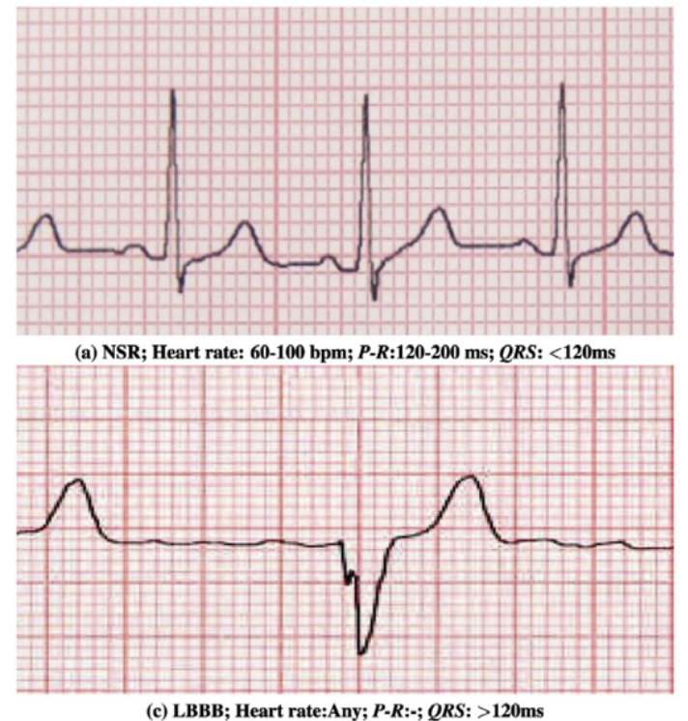
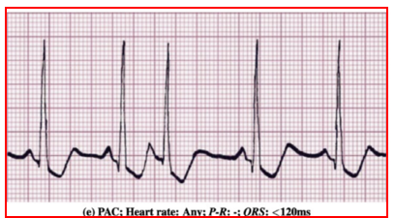
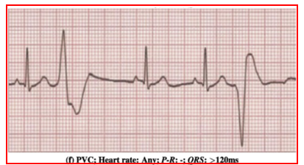
Now we are going to…
Original objectives
Extracting PAC, PVC among Normal waves during OP
Now objectives
Abnormal detection from ECG waves
Making references of NSR normal waves based on QRS complexes and R-R intervals
→ another way; using MIT Arrhythmia database’ annotations
Use MIT-BIH Normal Sinus Rhythm(NSR) Database (Goldberger et al., 2000)
18 longer ECG recordings of subjects, sampled at 128 Hz
A review on deep learning methods for ECG arrhythmia classification (2020)

Slide 23
Questions
What’s the meaning of PAC and PVC?
To Compare to other arrhythmia, do PAC and PVC have special meanings?
Further, to compare to other arrhythmia, do they have special meanings during OP?
How common are PAC and PVC in arrhythmia?
Is it easy to get PAC and PVC dataset?
Do PAC and PVC have clear consensus of their characteristics?
Can experts detect PAC and PVC easily?
among NSR
among Arrhythmia

Slide 24
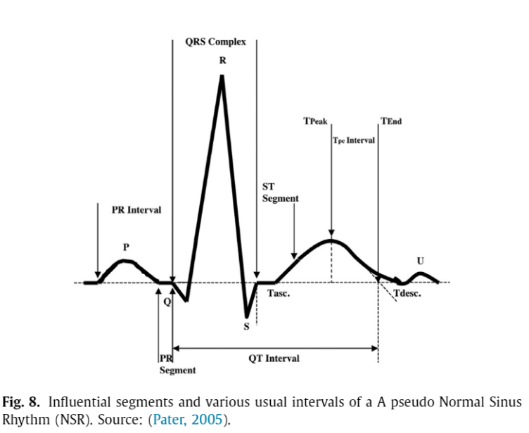
Medical Background
Q1
ECG Heartbeat sample with Meaningful segments
Atrial depolarization (P-wave)
Ventral depolarization (QRS complex wave)
Repolarization (T-wave)
A review on deep learning methods for ECG arrhythmia classification (2020)

Slide 25
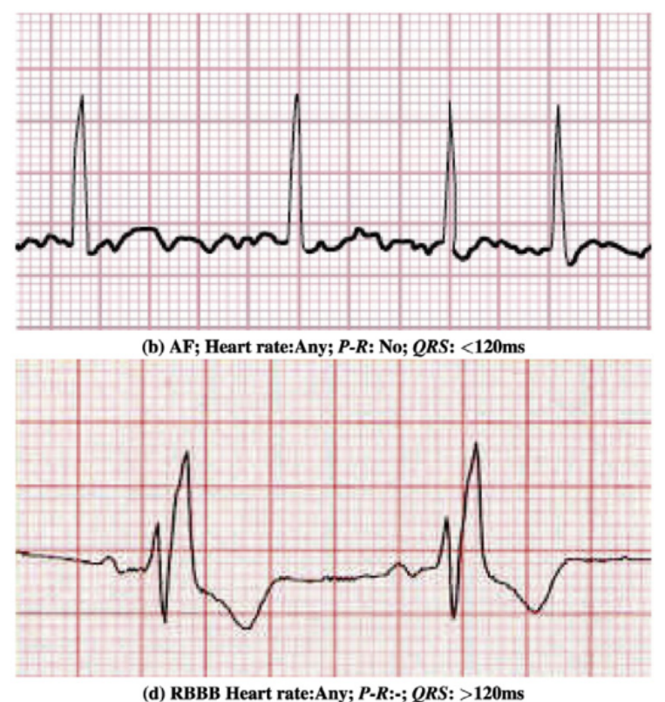
Medical Background
Q1
ECG Heartbeat with Arrhythmia
NSR
Atrial Fibrillation (AF)
Left Bundle Branch Block (RBBB)
Right Bundle Branch Block (LBBB)
Premature Atrial Contraction (PAC)
Premature Ventricular Contraction (PVC)
Ectopic beats (lead II and lead V1)
Myocardial Infarction (MI)
Sinus bradycardia
Tachycardia
Atrial or Supraventricular Tachycardia (SVT)
Sinus Tachycardia
Ventricular Tachycardia (VT)
Atrial Flutter (AFL)
Ventricular fibrillation (VFib)
Fusion beat
Ventricular Fusion Beats (VFB)
Atrial Fusion Beat (AFB)
Ventricular Flutter (VF)
Idioventricular rhythm
Ventricular bigeminy
Ventricular bigeminy
Pacemaker Rhythm
A review on deep learning methods for ECG arrhythmia classification (2020)

Slide 26
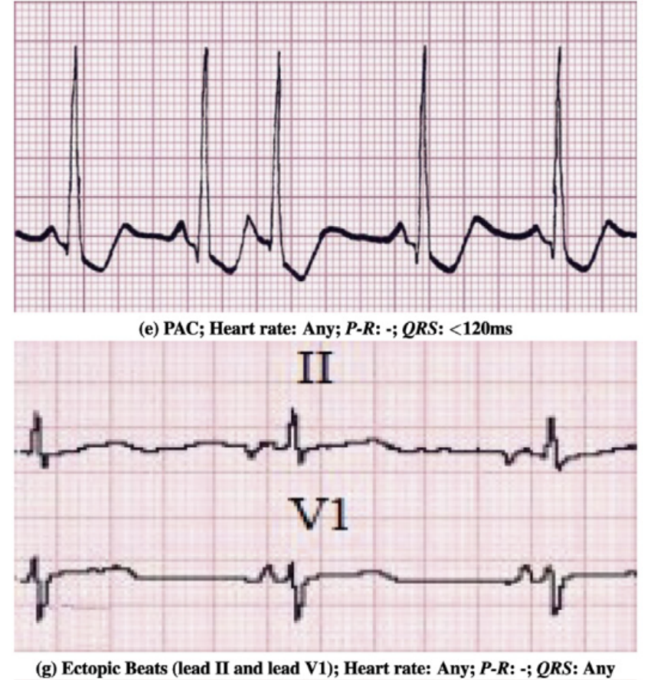
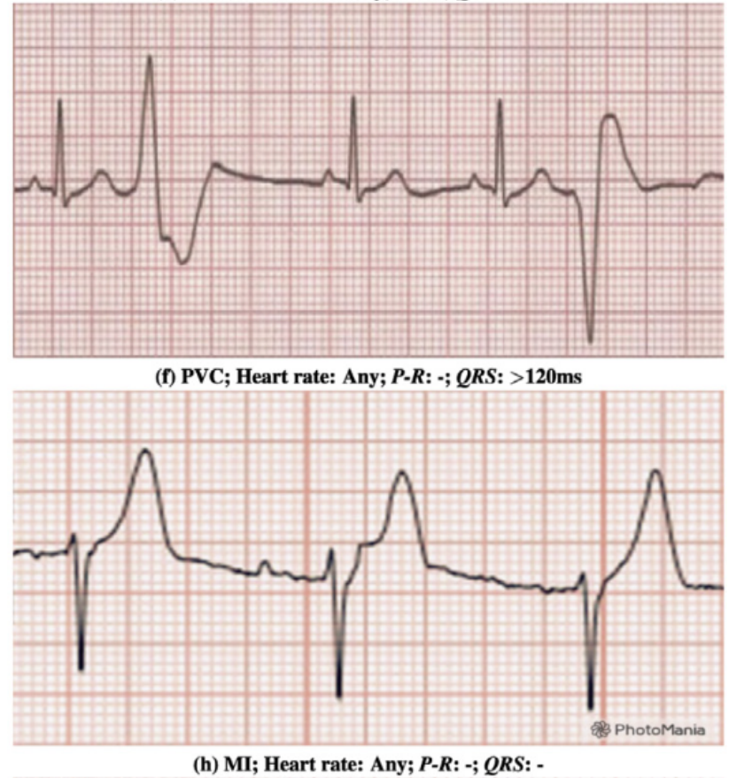
Medical Background
Q1
ECG Heartbeat with Arrhythmia
NSR
Atrial Fibrillation (AF)
Left Bundle Branch Block (RBBB)
Right Bundle Branch Block (LBBB)
Premature Atrial Contraction (PAC)
Premature Ventricular Contraction (PVC)
Ectopic beats (lead II and lead V1)
Myocardial Infarction (MI)
Sinus bradycardia
Tachycardia
Atrial or Supraventricular Tachycardia (SVT)
Sinus Tachycardia
Ventricular Tachycardia (VT)
Atrial Flutter (AFL)
Ventricular fibrillation (VFib)
Fusion beat
Ventricular Fusion Beats (VFB)
Atrial Fusion Beat (AFB)
Ventricular Flutter (VF)
Idioventricular rhythm
Ventricular bigeminy
Ventricular bigeminy
Pacemaker Rhythm
A review on deep learning methods for ECG arrhythmia classification (2020)

Slide 27
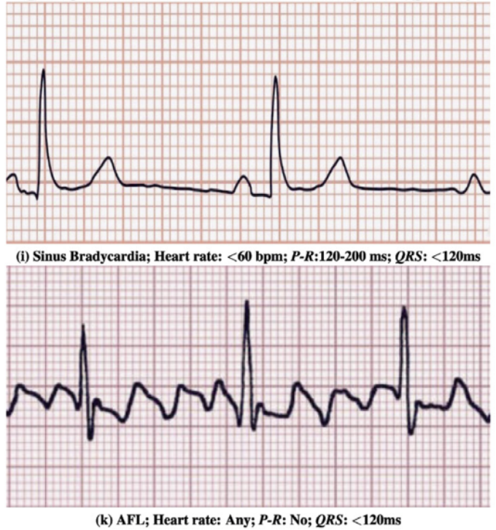
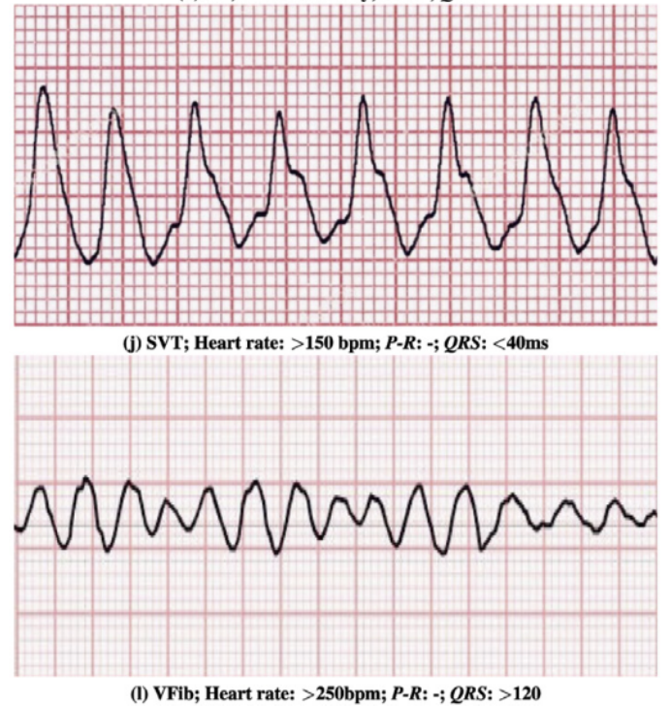
Medical Background
Q1
ECG Heartbeat with Arrhythmia
NSR
Atrial Fibrillation (AF)
Left Bundle Branch Block (RBBB)
Right Bundle Branch Block (LBBB)
Premature Atrial Contraction (PAC)
Premature Ventricular Contraction (PVC)
Ectopic beats (lead II and lead V1)
Myocardial Infarction (MI)
Sinus bradycardia
Tachycardia
Atrial or Supraventricular Tachycardia (SVT)
Sinus Tachycardia
Ventricular Tachycardia (VT)
Atrial Flutter (AFL)
Ventricular fibrillation (VFib)
Fusion beat
Ventricular Fusion Beats (VFB)
Atrial Fusion Beat (AFB)
Ventricular Flutter (VF)
Idioventricular rhythm
Ventricular bigeminy
Ventricular bigeminy
Pacemaker Rhythm
A review on deep learning methods for ECG arrhythmia classification (2020)

Slide 28
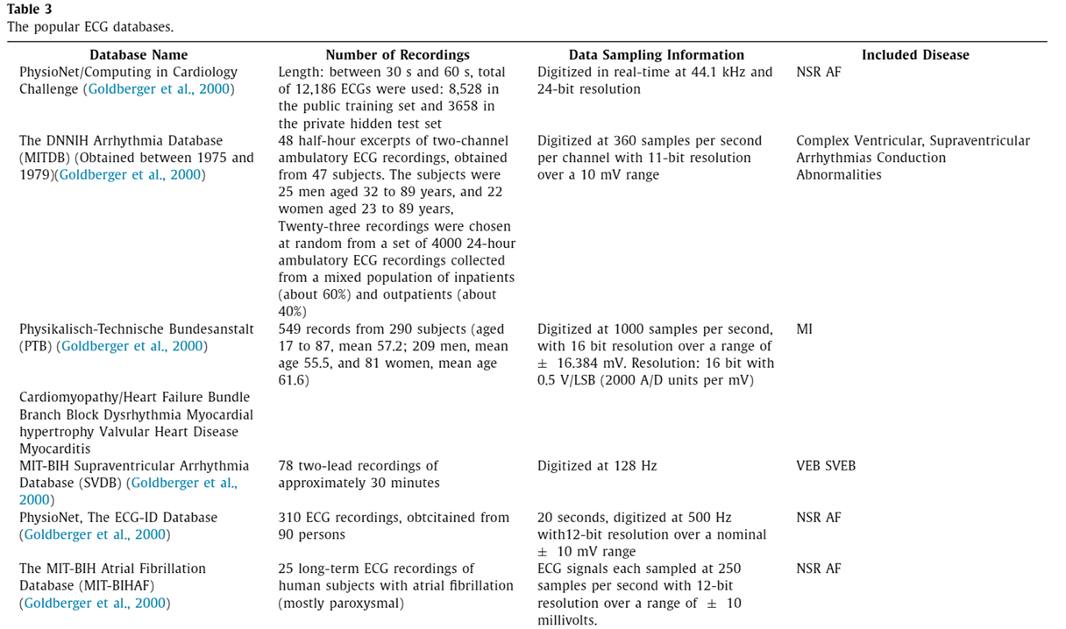
Databases
Q2
A review on deep learning methods for ECG arrhythmia classification (2020)

Slide 29
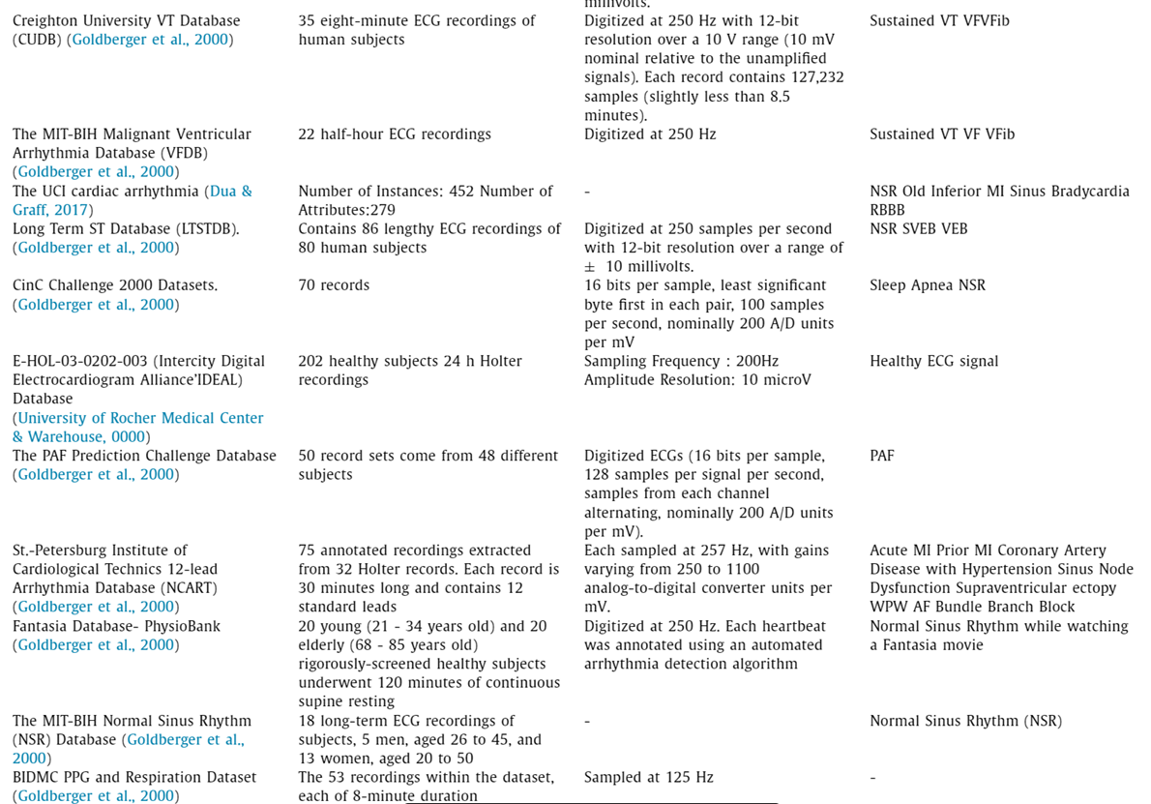
Databases
Q2
A review on deep learning methods for ECG arrhythmia classification (2020)

Slide 30
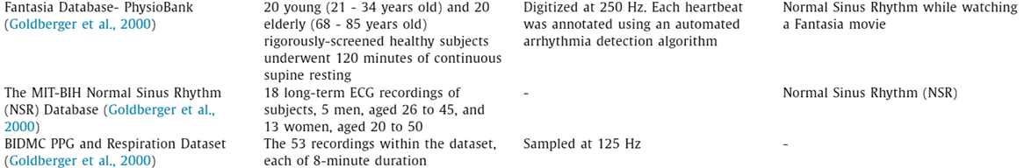
Databases
Q2
A review on deep learning methods for ECG arrhythmia classification (2020)

Slide 31
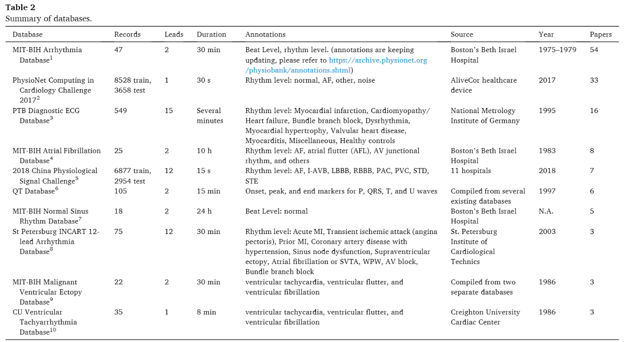
Databases
Q2
Opportunities and challenges of deep learning methods for electrocardiogram data_ A systematic review (2020)

Slide 32
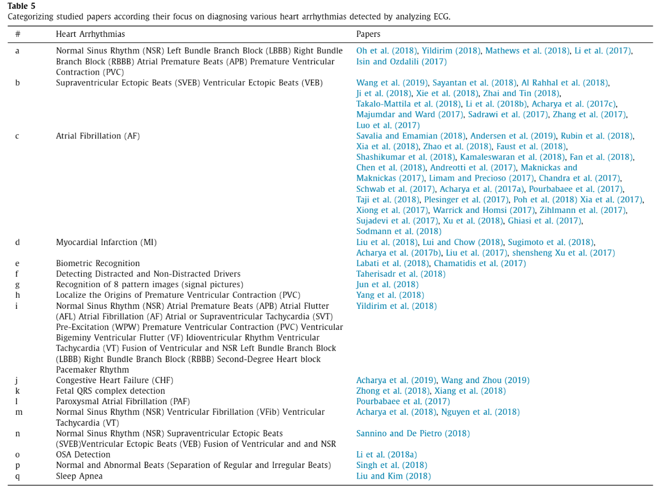
Q2
A review on deep learning methods for ECG arrhythmia classification (2020)

Slide 33
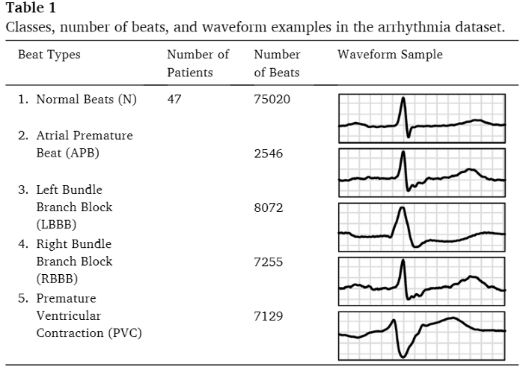
The Proportion of waves
Q2
Application of deep learning techniques for heartbeats detection using ECG signals-analysis and review (2020)

Slide 34
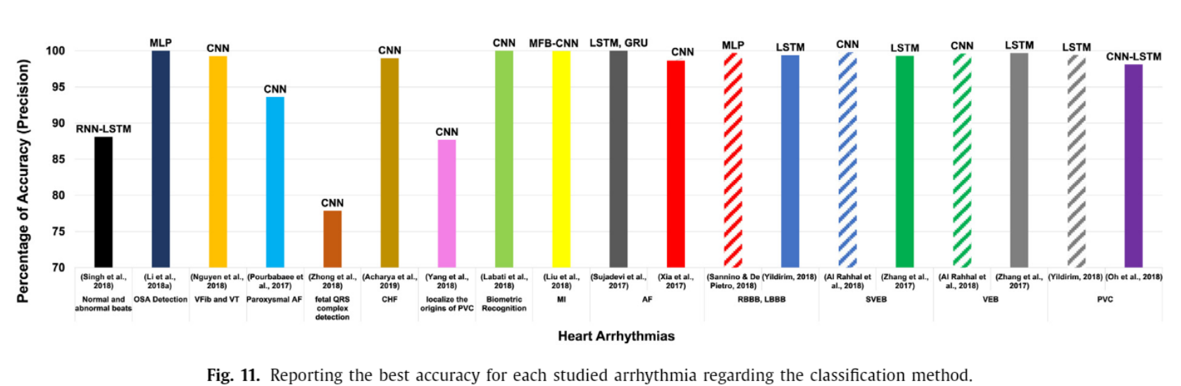
Deep Learning Techniques as a detector
Q3
A review on deep learning methods for ECG arrhythmia classification (2020)

Slide 35
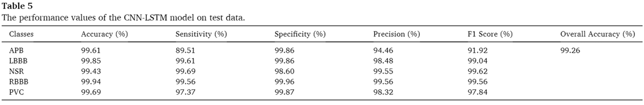
Deep Learning Techniques as a detector
Q3
Application of deep learning techniques for heartbeats detection using ECG signals-analysis and review (2020)

Slide 36
MIT-Arrythmia Database
Description
2021. 12. 02
Hyun-Jung Kim

Slide 37
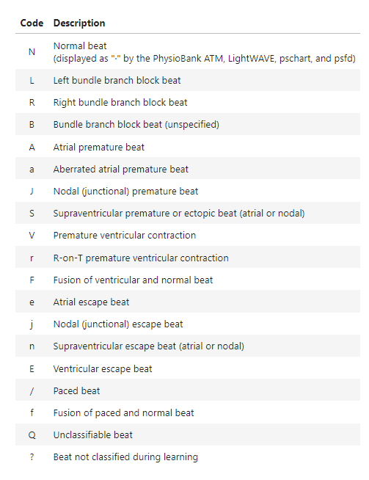
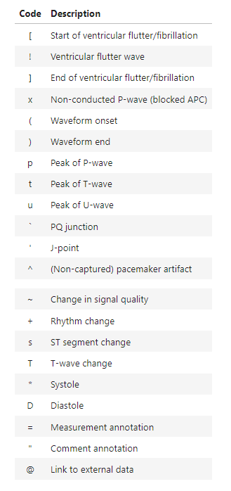
Annotations
Beat annotations
Non-Beat annotations
Abnormal
L, R, V, /, A, f, F, j, a, E, J, e, S
Non-beat
[, !, ], x, (, ), p, t, u, `, \, ^, |, ~, +, s, T, *, D, =, ", @, Q, ?

Slide 38
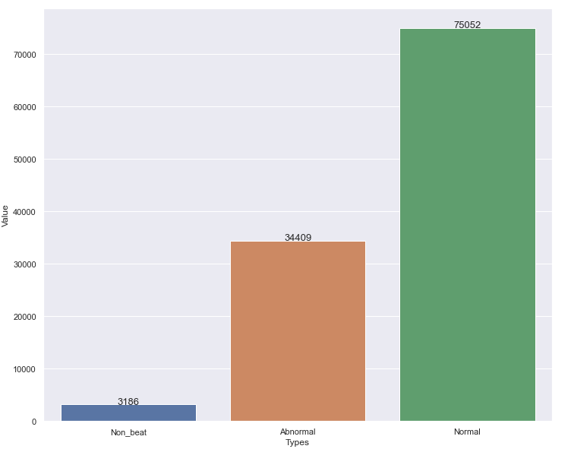
Types’ distribution
Total: 48 subjects
Type | Numbers
Normal | 75,052 (0.69)
Abnormal | 34,409 (0.31)
Non-beat | 3,186

